Slide 1
Zero: The history of an unappreciated number
Dr. Anthony O’Hare
Anthony.ohare@stir.ac.uk

Slide 2
In the beginning was the void…
Notes:
Nearly every culture has a creation myth or story, and most begin with an empty void and churning chaos. This concept was frightening to the western mind, so while the idea of zero spread and was used throughout the east, it was resisted and even called evil in the west.

Slide 3
I've put a number of cookies in that jar. You can have them if you give me your rubber duckie.
What is Zero?
Ok

Slide 4
What is Zero?
There are no cookies the jar. You said you put a number of cookies in the jar!
That's right, zero is a number!

Slide 5
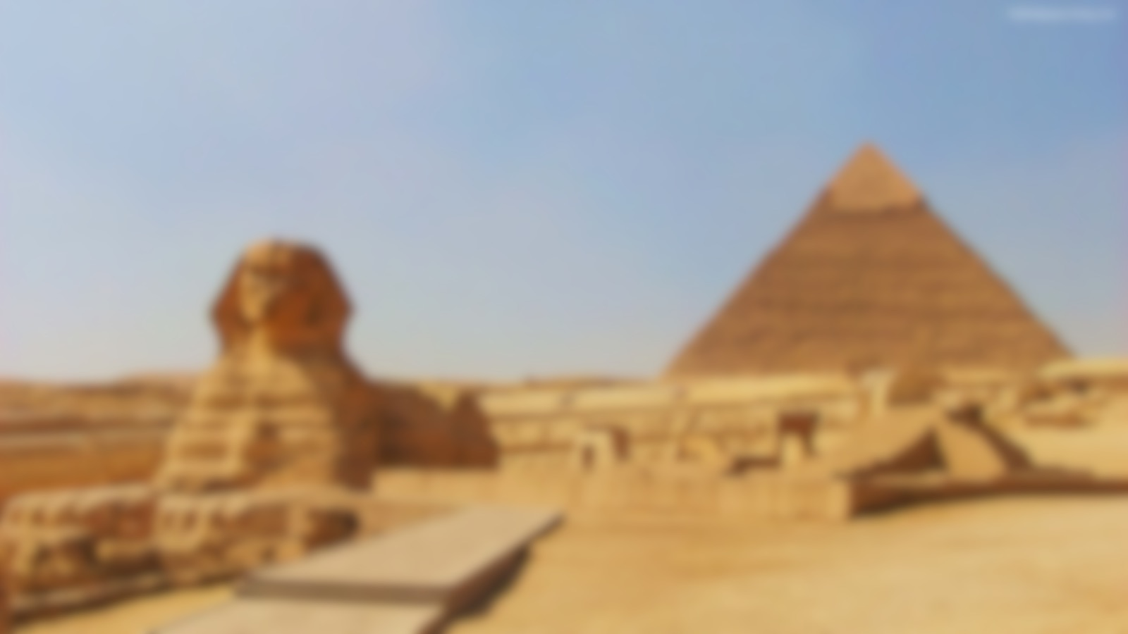
Ancient Egypt
Skilled engineers, astronomers and builders.
But used only elementary mathematics.
Notes:
Discovered the 3-4-5 rule for making right angles.

Slide 6
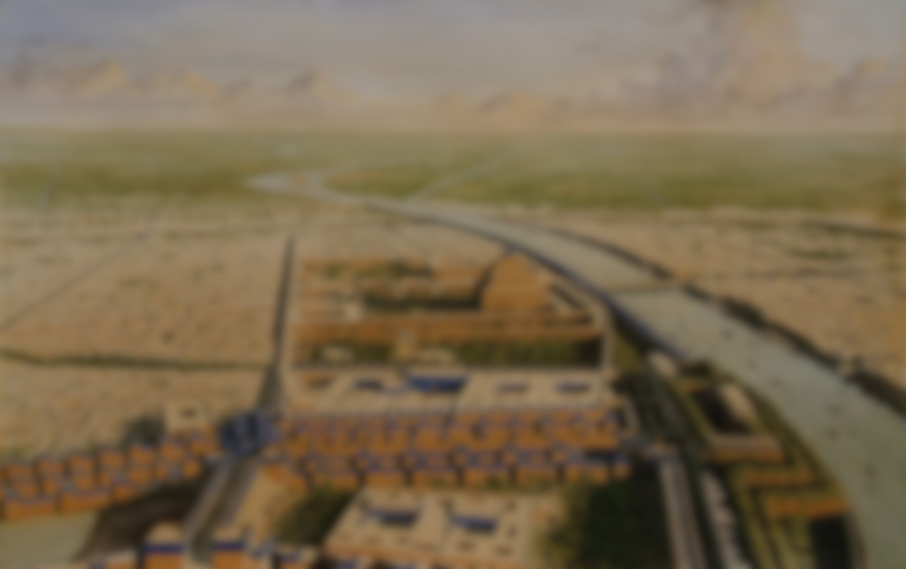
Babylonia (circa 1500BC)
The Babylonians used a base 60 counting system and used another of their inventions, the abacus, to do their arithmatic.
Notes:
The Sumerians were the first to develop a counting system to keep an account of their stock of goods - cattle, horses, and donkeys, for example. The Sumerian system was positional; that is, the placement of a particular symbol relative to others denoted its value. The Sumerian system was handed down to the Akkadians around 2500 BC and then to the Babylonians in 2000 BC.

Slide 7
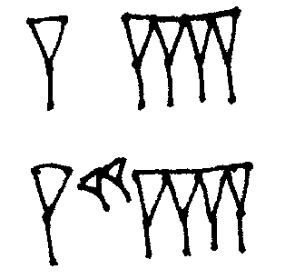
Babylonia
64 is written a one ‘sixty’ and 4 ‘ones’
But
3604 is written a one ‘sixty squared’ and 4 ‘ones’.
It is only possible if we use zero as a placeholder.
Notes:
only purpose of zero was as a placeholder, very much the way we use it today to distinguish 11 from 101
Despite the invention of zero as a placeholder, the Babylonians never quite discovered zero as a number.

Slide 8
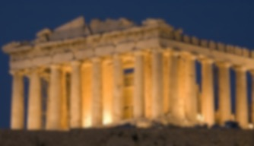
Classical Greece
The Greeks took the Egyptian mathematics and extended it, making it more abstract.
The Egyptian 3-4-5 rule for making triangles was generalised into what we now call Pythagoras theorem.
Notes:
Took the mathematics developed by the Egyptians and developed it. They were far more interested in the more abstract mathematics and geometry.
The renowned mathematicians among the Greeks, who learned the fundamentals of their math from the Egyptians, did not have a name for zero, nor did their system feature a placeholder as did the Babylonian.
For them numbers and shapes were synonymous, you couldn’t assign a shape to zero so it couldn’t exist (Pythagorean view).

Slide 9
Classical Greece
Aristotle argued that there is no void and that the planets revolved on their own orbs – this view was taken up by the Christian church (as we’ll see later).
Greek mathematicians rejected the idea of zero and the infinite on religious grounds.

Slide 10
Zeno’s Paradox
Notes:
Famous paradox atributed to Zeno (490BC):
Achilles and a tortoise have a race, and the tortoise has a 1 metre head start.
Achilles runs at 1 metre per second and the tortoise at half that speed.
After one second Achilles has reached the starting point of the tortoise but the tortoise has moved. It takes Achilles half a second to reach the tortoise who has moved again,
In this paradox Achilles can never reach the tortoise. Greek mathematicians knew something was wrong but couldn’t prove it – the problem is in that we have divided continuous motion into an infinite number of steps,
We are able to add an infinite number of steps to obtain zero but since the Greeks rejected zero, they couldn’t solve this.
More on series later…

Slide 11
Mayans (3rd AD)
The Mayans of Central America were highly skilled mathematicians and astronomers. They needed a placeholder for their complex calendar and date system.
Notes:
The Mayans also used zero as a place holder for their base 20 number system.

Slide 12
Mayans (3rd AD)
0 | 1 | 2 | 3 | 4
5 | 6 | 7 | 8 | 9
10 | 11 | 12 | 13 | 14
15 | 16 | 17 | 18 | 19
They invented zero 600 years and 12,000 miles removed from the Babylonians.
However, the Mayans used zero as a number in its own right and started counting from zero.

Slide 13
India (4th AD)
The idea of zero was brought by Alexander the Great to India where it was accepted and taken one step further – negative numbers.
The Hindu zero, unlike the Babylonians and the Mayans, came to be understood as meaning ‘nothing’.
Notes:
In India where it is believed that all creation came from the void, and the goal of the soul is to return to the void and the creator, the concept of null was easily accepted.
So, when Alexander the Great brought the Babylonian idea of zero as a place holder it was accepted and taken one step further. They used a base ten number system and assigned zero a numerical value.
The numerical system we use today evolved from this system. This acceptance of the number zero allowed the Indian mathametians to develop another new concept, ”the negative number”. If zero had a numerical vale then you could have less than zero, as in 2-3=-1.

Slide 14
Brahmagupta: 598-665(?)
Developed the rules for arithmetic involving zero.
x-0=x 0/x=0
x+0=x x/0=0
0+0=0 0/0=0
0-0=0 x×0 = 0

Slide 15
Bhaskara 1114-1185
Built upon Brahmagupta’s work,
0²=0 √0=0
Notes:
Given that he was building on the knowledge and understanding of Brahmagupta it is not surprising that Bhaskaracharya understood about zero and negative numbers.
However his understanding went further even than that of Brahmagupta.

Slide 16
China (7th AD)
China independently invented place value.
But didn’t make the leap to zero until it was
introduced to them by a Buddhist astronomer in 718
Notes:
Although it seems strange to image a place value system with no place holder for “nothing,” it makes perfect sense when you see the Chinese method for writing and calculating numbers.
The Chinese used a counting board to do their math, and an additive system to write their numbers.
Any missing places were left blank on the counting board. After the introduction of the zero symbol, the counting board could be retired.

Slide 17
Modern Zero
The great Arabian voyagers would bring the texts of Brahmagupta and his colleagues back from India along with spices and other exotic items.
Zero reached Baghdad by 773 AD and would be developed in the Middle East by Arabian mathematicians who would base their numbers on the Indian system
Notes:
In the seventh century AD the Arabic Empire began its conquest, spreading from Egypt, Syria, Persia and Jerusalem, to the Indus River in the east and the Algiers in the West. By the middle of the eighth century they were in control of Spain and India and China, absorbing the wisdom of the people they conquered along with the Indian numerical system.
This work was the first in what is now Iraq to use zero as a place holder in positional base notation.
Al'Khwarizmi describes the Indian place-value system of numerals based on 1,2,3,4,5,6,7,8,9 and 0.
By 879 AD, zero was written almost as we now know it, an oval - but in this case smaller than the other numbers. And thanks to the conquest of Spain by the Moors, zero finally reached Europe; by the middle of the twelfth century, translations of Al-Khowarizmi's work had weaved their way to England.

Slide 18
Modern Zero
In the ninth century, Mohammed ibn-Musa al-Khowarizmi was the first to work on equations that equaled zero, or algebra as it has come to be known.
Al-Khwarizmi called zero 'sifr', from which our cipher is derived.
The Hindu-arabic number system reached Europe in the C11 through Spain.
Leonadro Fibonacci is attributed with introducing zero from translations of Al-Khwarizmi.
Notes:
The Hindu-Arabic numeral system (base 10) reached Europe in the 11th century, via the Iberian Peninsula through Spanish Muslims in the Middle ages
Introduced in Europe by Leonardo Fibonacci. Translation from Al-Khwarizmi.
Fibonacci, an Italian educated in North Africa, learned Arabic mathematics and introduced them to the western world in his book, “Liber Abaci”, published in 1202. Italian bankers and merchants found Arabic numbers and calculation so much easier than previous methods that they accepted it and zero immediately.

Slide 19
Zero and the Christian Church
At first the Christian Church opposed zero and the void arguing that if God is omnipotent and great then the absence of God (zero) was evil.
In C12 , Maimonides, a Jewish mathematician living in Muslim Spain, argued against Aristotle and the Christian view of zero saying this view contradicted the bible which stated God created the world out of the void.
Notes:
In the twelfth century, Maimonides, a Jewish mathematician and Rabbi living in a Spain under Muslin rule declared that Aristotle was wrong. For Aristotle the universe had always existed. Maimonides said this contradicted the Bible, which stated that God created the world out a void. Now Zero became acceptable to Jewish scholars as well.
The final resistance to zero was broken during the twelfth and thirteenth centuries. Peasants, noblemen, monks, and even children went off to fight the infidels. Many never to return, but those who did brought with them Eastern ideas, as well as silks and leprosy. In 1277 Tempier, a bishop in Paris, declared that to say that God could not create from a void was to say that God was not all powerful. Zero was beginning to gain acceptance in the west.
The government and Church still resisted this change and in 1299 Florence outlawed the use of Arabic numerals on the grounds that the numbers were too easily altered. Businessmen continued to use them, even using them to send code messages. Now zero and Arabic numerals were an accepted form of calculation .

Slide 20
Zero and the Christian Church
Those who returned from the crusades in C12 and C13 brought the idea of zero with them.
1277: Tempier, a bishop in Paris, declared that to say God could not create the world from the void was to say he wasn’t all powerful.
The government and Church still resisted and arabic numbers were outlawed in Florence in 1299 as they were too easily altered – busisnessmen stil used them as they were convenient.
Notes:
The final resistance to zero was broken during the twelfth and thirteenth centuries. Peasants, noblemen, monks, and even children went off to fight the infidels. Many never to return, but those who did brought with them Eastern ideas, as well as silks and leprosy. In 1277 Tempier, a bishop in Paris, declared that to say that God could not create from a void was to say that God was not all powerful. Zero was beginning to gain acceptance in the west.
The government and Church still resisted this change and in 1299 Florence outlawed the use of Arabic numerals on the grounds that the numbers were too easily altered. Businessmen continued to use them, even using them to send code messages. Now zero and Arabic numerals were an accepted form of calculation .
Up until the 13th century Europe was still using roman numerals.

Slide 21
Until the C13 Europe was still using Roman Numerals. To write 3333 they needed to write MMMCCCXXXIII.
Multiplication was a pain and division a nightmare.
With the invention of the printing press ‘arabic’ numbers were adopted en-masse as they were easier to typeset.
Notes:
By 1550, the new numerals were the dominant number system across Europe, and mathematics was once again in growth.

Slide 22
Infinite Zeroes
Zeno’s Paradox:
$1+\frac{1}{2}+\frac{1}{4}$ + $\frac{1}{8}$ + $\frac{1}{16}$+ … = 2
First person to be able to solve this sort of problem was Richard Suiset, in Oxford, C14. However, not all infinite series has such neat solutions.
$\frac{1}{2}+\frac{1}{3}$ + $\frac{1}{4}$ + $\frac{1}{5}$+ $\frac{1}{6}$ + ...

Slide 23
Nicole Oresme (C14), grouped terms together and was shocked as each group was greater than ½, and so the infinite series of terms that got smaller added together to infinity!
$(\frac{1}{2})+(\frac{1}{3}$ + $\frac{1}{4}$) + ($\frac{1}{5}$+ $\frac{1}{6}$ + $\frac{1}{7}$ + $\frac{1}{8}$) + ...
…even though each term gets smaller it doesn’t do so fast enough!

Slide 24
Infinite series of zeroes get even weirder….
$$1−1+1−1+1−1+1−1+1−1+…= ?$$
($1−1)+(1−1)+(1−1)+(1−1)+(1−1)+…=0+0+0+0+…=0$
or
$$1+\left(−1+1\right)+\left(−1+1\right)+\left(−1+1\right)+\left(−1+1\right)+…=1+0+0+0+…=1$$
Guido Grandi (1671 – 1742) used this to prove that God can create the universe (1) out of nothing (0).

Slide 25
Decartes, 1596 -1650
Notes:
Invented what we know as Cartesian coordinate system. Coordinate represents location in space but this requires an origin (left or right of where?).
Mathematicians were now able to represent geometric shapes by equations and zero was at the centre of this.

Slide 26
Kepler (1571 – 1630), tried estimating the volume of wine barrels by slicing them up and putting them back together again.
8
Area of triangle = 32
Area of square = 16
4
4
8

Slide 27
8
Area of triangle = 32
Area of square = 12 + 8 + 4 = 24
8
Area of triangle = 32
Area of square = 28
6
4
4
2
2
4
6
8
4
8

Slide 28
As the area of the slices got closer to zero, the closer Kepler got to the correct answer.
Bonaventura Cavalieri (1598-1647) did the same thing for other geometric shapes. Adding lots of zero areas or zero volumes to get the correct result.
This method of infinitesimals was also used to solve an important problem in C17 mathematics …

Slide 29
Tangents
Mathematicians were becoming interested in the laws of motion and recognised the importance of ’the tangent’ to a curve at a point.
Notes:
A tangent is a line that just ‘kisses’ a curve.
Really important for studying motion because bound objects would ‘fly off at a tangent’ if the binding force were removed.

Slide 30
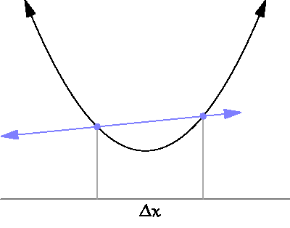
To calculate the tangent:
Take a nearby point on the curve.
Draw a line connecting this point to where you want the tangent.
Move your point until it is infinitesimally close to the required point.
When points are ‘zero’ distance away from each other you have the tangent.
https://en.wikipedia.org/wiki/Derivative

Slide 31
To calculate the tangent:
But what we want to know is the slope of the tangent. i.e. how fast the tangent line is increasing per unit distance.
But we’ve brought the points together so to calculate the slope we need to divide by zero!!!!!!
Notes:
Can sum infinite series
Can calculate the area and volume of complicated shapes
Can calculate tangent lines
… but all methods rely on either dividing by zero or adding zero lots of times...

Slide 32
Isaac Newton (1642 – 1726)
Calculus:
Fluxions & Fluents
$$y=x^{2}+x+1$$
Notes:
Newton’s calculus was based on the idea of variables that ‘flow’ in time, fluxions and small changes (fluents).
He used a mathematical trick, letting y and x change and represented the changes as y dot and x dot.

Slide 33
Newton’s Calculus
In an infinitesimally small time let y change and be denoted by $y+ο\dot{y}$
Now
$$(y+ο\dot{y)}={\left(x+ο\dot{x}\right)}^{2}+ \left(x+ο\dot{x}\right)+1$$

Slide 34
Newton’s Calculus
In an infinitesimally small time let y change and be denoted by $y+ο\dot{y}$
Now
$$(y+ο\dot{y)}={\left(x+ο\dot{x}\right)}^{2}+ \left(x+ο\dot{x}\right)+1$$
$$(y+ο\dot{y)}=x^{2}+2x\left(ο\dot{x}\right)+{\left(ο\dot{x}\right)}^{2}+ \left(x+ο\dot{x}\right)+1$$

Slide 35
Newton’s Calculus
In an infinitesimally small time let y change and be denoted by $y+ο\dot{y}$
Now
$$(y+ο\dot{y)}={\left(x+ο\dot{x}\right)}^{2}+ \left(x+ο\dot{x}\right)+1$$
$$(y+ο\dot{y)}=x^{2}+2x\left(ο\dot{x}\right)+{\left(ο\dot{x}\right)}^{2}+ \left(x+ο\dot{x}\right)+1$$
$$y+ο\dot{y}=x^{2}+x+1+2x\left(ο\dot{x}\right)+{\left(ο\dot{x}\right)}^{2}+ \left(ο\dot{x}\right)$$

Slide 36
Newton’s Calculus
In an infinitesimally small time let y change and be denoted by $y+ο\dot{y}$
Now
$$(y+ο\dot{y)}={\left(x+ο\dot{x}\right)}^{2}+ \left(x+ο\dot{x}\right)+1$$
$$(y+ο\dot{y)}=x^{2}+2x\left(ο\dot{x}\right)+{\left(ο\dot{x}\right)}^{2}+ \left(x+ο\dot{x}\right)+1$$
$$ο\dot{y}=2x\left(ο\dot{x}\right)+{\left(ο\dot{x}\right)}^{2}+ \left(ο\dot{x}\right)$$

Slide 37
Newton’s Calculus
$$ο\dot{y}=2x\left(ο\dot{x}\right)+{\left(ο\dot{x}\right)}^{2}+ \left(ο\dot{x}\right)$$
$$\frac{ο\dot{y}}{ο\dot{x}}=2x+1$$
Correct result
BUT, we’re dividing by zero!
Notes:
Liebiz calculus was slightly different but suffered from the same divide by zero problem.

Slide 38
Guillaume de l’Hôpital (1661-1704
Analyse des Infiniment Petits pour l'Intelligence des Lignes Courbes 1696
The rule that bears his name was one of the first attempts to solve the 0/0 problem in mathematics.
A fraction can be evaluated by calculating the derivatives of the numerator and denominator.
Notes:
lHopital’s rule was not invented by him but by Bernouilli, whom he employed. The agreement was that l”Hopital could publish the results under his name in return for money.

Slide 39
l’Hôpital’s Rule
At $x=0, \frac{x}{\sin{x}}=0$
However, taking derivatives*, $\frac{x}{\sin{x}}→\frac{1}{\cos{x}}=1, when x=0$
Actually, we can solve $\frac{0}{0}$ to be anything we like depending on the functions we use, that is why we say $\frac{0}{0}$ is indeterminate.
* Ignore the divide by zero problem in doing the derivative
Notes:
Zero is now not to be feared but a problem to be studied.

Slide 40
Jean le Rond d'Alembert (1717-1783
The solution came when d’Alembert wrote Zeno’s paradox as
$$\lim_{n→∞}\left(1+\frac{1}{2}+\frac{1}{4}\text{ + }\frac{1}{8}\text{ + }\frac{1}{16}+…+\frac{1}{2^{n}}\right)$$
Notes:
This subtle change separates the process from the goal and now Newtonian calculus need not talk about infinitesimals or dividing by zero but can talk about the limit as a value goes to zero.

Slide 41
… and I’ve not even mentioned projective geometry, complex numbers, Cantors sets.
... Or singularities, black holes, absolute zero, zero-wavelength and the ultraviolet catastrophe, zero-point energy...

Slide 42
Bibliography
Kaplan, Robert (2000). The Nothing that Is: A Natural History of Zero. New York: Oxford University Press.
Seife, Charles (2000). Zero: The Biography
Wikipedia

Slide 43
Next lecture
The incredible shrinking computer: Computer hardware from relays to 14 nanometre transistors.
Thursday 14 April
Prof Leslie Smith

